Slide 1
LOGISTICS OPTIMIZATION FOR DELIVERY ROUTES
SQL-Driven Analytics Dashboard

Slide 2
PROJECT OVERVIEW
🎯 BUSINESS CHALLENGE
Amazon faces delivery delays affecting:
• Customer Satisfaction ❌
• Operational Costs ❌
🔍 OUR SOLUTION:
SQL Analytics System to:
• Identify delay root causes
• Optimize delivery routes
• Improve shipping efficiency

Slide 3
DATASET OVERVIEW
📊 5 KEY TABLES ANALYZED
• Orders (300+ records)
• Routes (20 routes)
• Warehouses (10 locations)
• Delivery Agents (50 agents)
• Shipment Tracking (checkpoints)
🛠️ Tools: MySQL Workbench
Video link: Video

Slide 4
Task 1: Data Cleaning & Preparation
Removed Duplicate Order_IDs
SELECT Order_ID, COUNT(*) AS duplicate_count
FROM orders
GROUP BY Order_ID
HAVING COUNT(*) > 1;
no duplicates found
Filled NULL Traffic_Delay_Min with Route Average
UPDATE routes
SET Traffic_Delay_Min = (SELECT
AVG(Traffic_Delay_Min) FROM routes )
WHERE Traffic_Delay_Min IS NULL;
no nulls found
Verified Date Logic
ALTER TABLE orders ADD COLUMN flag TEXT;
UPDATE orders SET flag = 'Invalid' WHERE Actual_Delivery_Date < Order_Date;
SELECT * FROM orders WHERE flag = 'Invalid';
no invalid records found
Standardized Date Format
YYYY-MM-DD format already applied

Slide 5
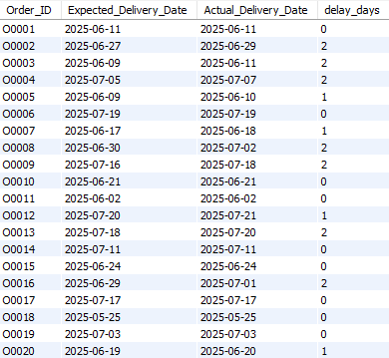
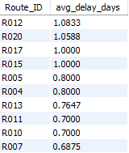
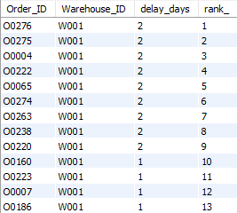
Task 2: Delay Analysis
Delay Calculation
SELECT
Order_ID,
Expected_Delivery_Date,
Actual_Delivery_Date,
DATEDIFF(Actual_Delivery_Date,
Expected_Delivery_Date) AS delay_days
FROM
orders;
Top 10 Delayed Routes
SELECT
Route_ID,
AVG(DATEDIFF(Actual_Delivery_Date,
Expected_Delivery_Date)) AS avg_delay_days
FROM
Orders
GROUP BY Route_ID
ORDER BY avg_delay_days DESC
LIMIT 10;
Warehouse-Level Delay Ranking
SELECT
Order_ID,
Warehouse_ID,
DATEDIFF(Actual_Delivery_Date, Expected_Delivery_Date) AS delay_days,
ROW_NUMBER() OVER (PARTITION BY Warehouse_ID ORDER BY
DATEDIFF(Actual_Delivery_Date, Expected_Delivery_Date) DESC) AS rank_
FROM orders
ORDER BY Warehouse_ID, delay_days DESC;

Slide 6
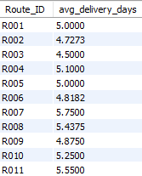
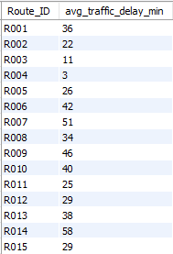
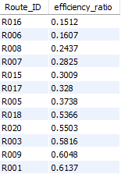
Task 3: Route Optimization Insights
Average delivery time (in days)
SELECT
Route_ID,
ROUND(AVG(DATEDIFF(Actual_Delivery_Date, Order_Date)),
4) AS avg_delivery_days
FROM
orders
GROUP BY Route_ID
ORDER BY Route_ID;
Average traffic delay
SELECT
Route_ID, Traffic_Delay_Min AS avg_traffic_delay_min
FROM
routes
ORDER BY Route_ID;
Distance-to-time efficiency ratio
SELECT
Route_ID,
ROUND(Distance_KM / Average_Travel_Time_Min, 4) AS efficiency_ratio
FROM routes
ORDER BY efficiency_ratio ASC;

Slide 7

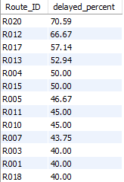
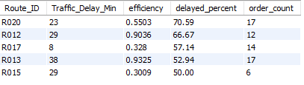
Task 3: Route Optimization Insights
3 routes with the WORST efficiency ratio
SELECT
Route_ID,
ROUND(Distance_KM / Average_Travel_Time_Min, 4) AS efficiency_ratio
FROM
routes
ORDER BY efficiency_ratio ASC
LIMIT 3;
routes with >20% delayed shipments
SELECT
Route_ID,
ROUND((COUNT(CASE
WHEN Delivery_Status = 'Delayed' THEN 1
END) * 100.0 / COUNT(*)),
2) AS delayed_percent
FROM
orders
GROUP BY Route_ID
HAVING delayed_percent > 20
ORDER BY delayed_percent DESC;
TOP 5 routes needing optimization
SELECT
r.Route_ID,
r.Traffic_Delay_Min,
ROUND(r.Distance_KM / r.Average_Travel_Time_Min, 4) AS efficiency,
ROUND((COUNT(CASE WHEN o.Delivery_Status = 'Delayed' THEN 1 END) *
100.0 / COUNT(*)), 2) AS delayed_percent,
COUNT(*) AS order_count
FROM routes r
JOIN orders o ON r.Route_ID = o.Route_ID
GROUP BY r.Route_ID, r.Traffic_Delay_Min, r.Distance_KM,
r.Average_Travel_Time_Min
HAVING delayed_percent > 50 OR efficiency < 0.5 OR Traffic_Delay_Min > 40
ORDER BY delayed_percent DESC, efficiency ASC
LIMIT 5;

Slide 8

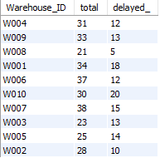
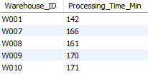
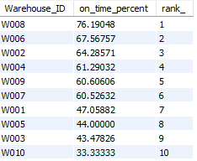
TASK 4 – WAREHOUSE PERFORMANCE
Top 3 Slowest Processing Time
SELECT Warehouse_ID, Processing_Time_Min
FROM warehouses
ORDER BY Processing_Time_Min DESC
LIMIT 3;
Total vs. delayed shipments for each warehouse
SELECT
Warehouse_ID,
COUNT(*) AS total,
COUNT(CASE
WHEN Delivery_Status = 'Delayed' THEN 1
END) AS delayed_
FROM
Orders
GROUP BY Warehouse_ID;
Bottleneck warehouses
WITH global_avg AS (SELECT AVG(Processing_Time_Min)
AS avg FROM warehouses)
SELECT w.Warehouse_ID, w.Processing_Time_Min
FROM warehouses w, global_avg g
WHERE w.Processing_Time_Min > g.avg;
Warehouses rank
SELECT Warehouse_ID, (COUNT(CASE
WHEN Delivery_Status = 'On Time'
THEN 1 END) * 100.0 / COUNT(*)) AS
on_time_percent,
ROW_NUMBER() OVER (ORDER BY
(COUNT(CASE WHEN Delivery_Status =
'On Time' THEN 1 END) * 100.0 /
COUNT(*)) DESC) AS rank_
FROM orders
GROUP BY Warehouse_ID;

Slide 9

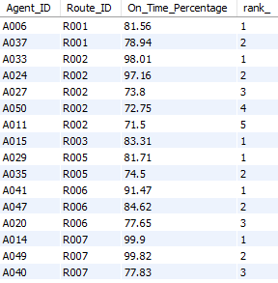
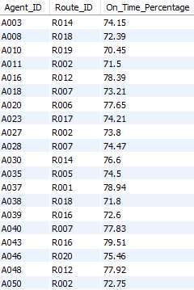
TASK 5 – DELIVERY AGENT PERFORMANCE
Rank agents (per route)
SELECT
Agent_ID, Route_ID, On_Time_Percentage,
ROW_NUMBER() OVER (PARTITION BY Route_ID ORDER
BY On_Time_Percentage DESC) AS rank_
FROM deliveryagents;
Agents with on-time %
SELECT
Agent_ID, Route_ID, On_Time_Percentage
FROM
deliveryagents
WHERE
On_Time_Percentage < 80;
Average speed of top 5 vs bottom 5 agents
SELECT 'TOP 5 Agents' AS category,
ROUND(AVG(Avg_Speed_KM_HR), 2) AS avg_speed_kmh
FROM (
SELECT Avg_Speed_KM_HR
FROM deliveryagents
ORDER BY On_Time_Percentage DESC
LIMIT 5)
top_agents
UNION ALL
SELECT 'BOTTOM 5 Agents' AS category,
ROUND(AVG(Avg_Speed_KM_HR), 2) AS avg_speed_kmh
FROM (
SELECT Avg_Speed_KM_HR
FROM deliveryagents
ORDER BY On_Time_Percentage ASC
LIMIT 5
) bottom_agents;

Slide 10
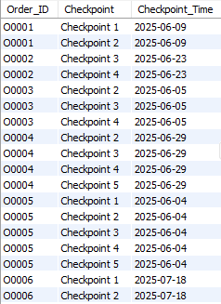
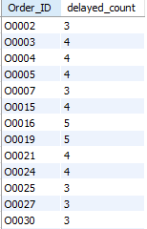

TASK 6 – SHIPMENT TRACKING ANALYTICS
The last checkpoint and time
SELECT
Order_ID, Checkpoint, Checkpoint_Time
FROM
shipmenttracking
WHERE
Checkpoint_Time = (SELECT
MAX(Checkpoint_Time)
FROM
shipmenttracking s2
WHERE
s2.Order_ID = shipmenttracking.Order_ID);
Common delay reasons
SELECT
Delay_Reason, COUNT(*) AS count
FROM
shipmenttracking
WHERE
Delay_Reason != 'None'
AND Delay_Reason IS NOT NULL
GROUP BY Delay_Reason
ORDER BY count DESC
LIMIT 1;
orders with >2 delayed checkpoints
SELECT
Order_ID, COUNT(*) AS delayed_count
FROM
shipmenttracking
WHERE
Delay_Reason != 'None'
AND Delay_Reason IS NOT NULL
GROUP BY Order_ID
HAVING delayed_count > 2;

Slide 11
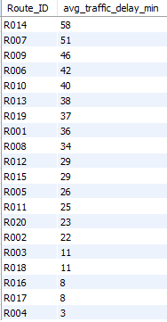
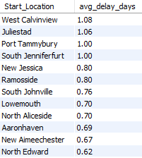

Task 7: Advanced KPI Reporting
Average Delivery Delay per Region
On-Time Delivery %
SELECT
ROUND((COUNT(CASE
WHEN Delivery_Status = 'On Time' THEN 1
END) * 100.0 / COUNT(*)),
2) AS on_time_percent
FROM
orders;
Average Traffic Delay per Route
SELECT
r.Route_ID,
r.Traffic_Delay_Min AS avg_traffic_delay_min
FROM routes r
ORDER BY r.Traffic_Delay_Min DESC;
SELECT
r.Start_Location,
ROUND(AVG(DATEDIFF(o.Actual_Delivery_Date,
o.Expected_Delivery_Date)),
2) AS avg_delay_days
FROM
orders o
JOIN
routes r ON o.Route_ID = r.Route_ID
GROUP BY r.Start_Location
ORDER BY avg_delay_days DESC;

